Slide 1


Impact engagement purpose respect
MEGA MENTORS
Linda Thomas 07/03/20 Draft

Slide 2

WHAT IS IT?
Communication is the process of sending and receiving messages that allow people to share information, ideas and knowledge. Verbal and Non-verbal
AN EXCHANGE
Notes:
Can communication be one way?

Slide 3
WHY DO IT?
Three Purposes of Communication
Inform – the anticipated outcome is to share knowledge. No action is expected of the receiver. No deadline or time frame is required
Persuade – the anticipated outcome is to change attitudes to effect an action. The executive may or may not take the action, depending in whole, or in part, on the strength of the communication
Direct – the anticipated outcome is to initiate an action. The outcome can be measured by whether the action occurred. Usually, a deadline or time frame is stated explicitly.
Notes:
We all determine which purpose our communication falls into. Sometimes it is more than one area.
WHAT DO YOU FEEL MORE OFTEN IS THE COMMUNCIATION PURPOSE WHEN YOU SPEAK TO:
PARENTS
SCHOOL
PEERS

Slide 4







HOW WE DO IT
WRITE & SPEAK
SPEAK
VISUAL/EMOJIS
WRITE
SPEAK
NON-VERBAL
WRITE & SPEAK
Notes:
Most people think about communication as speaking to someone, but communication actually has 2 components, with a lot of examples within each component – VERBAL (spoken and written) and NONVERBAL (communication without words and includes pictures, such behaviors as facial expressions, touching, gestures, posture, body language and spatial distance between two people.
Verbal – speaking to one or more people, making sounds
Written – on paper, via smart phones and the computer
Non-verbal – our body language and facial expressions
Visual – use of pictures to depict how we’re feeling. I.e. emojis
IN-PERSON
VIRTUALLY
FACILITATOR - ASK STUDENTS TO SHARE HOW THEY COMMUNICATE THE MOST and when/ why they would use different formats. If no volunteers call upon 2 students.

Slide 5
MORE TO“SAY”
How you say it – including the tone of your voice
Why you say it – the intention behind your message

Slide 6
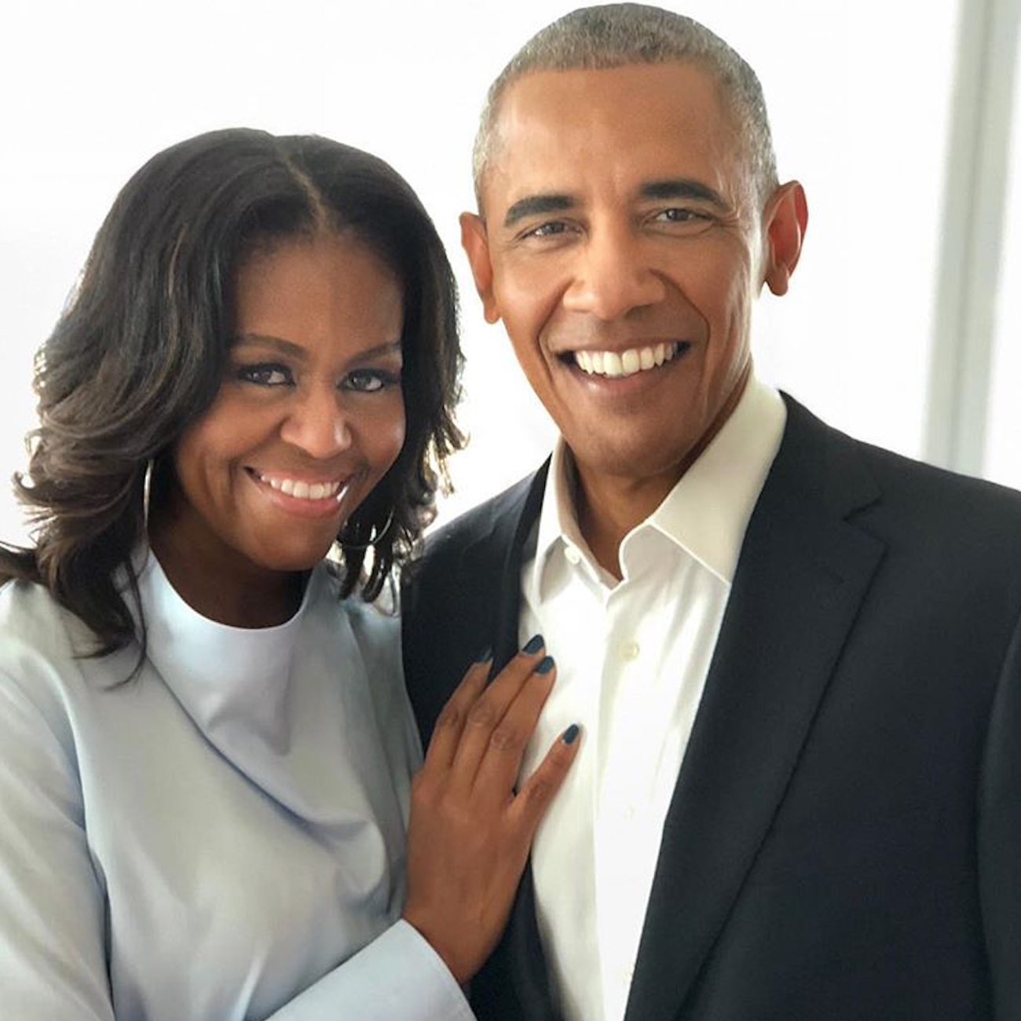
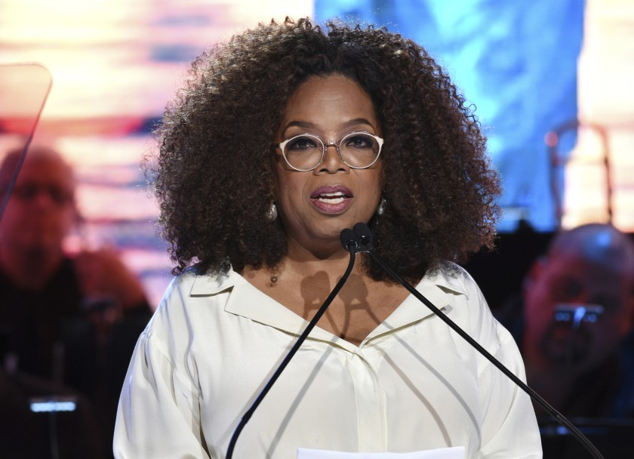
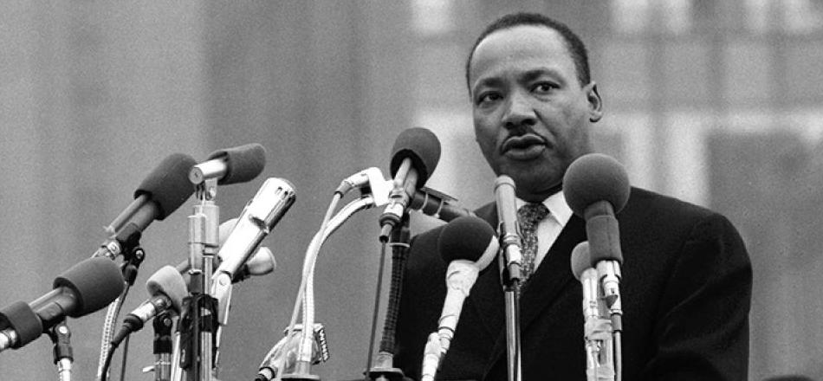
EFFECTIVE COMMUNICATORS
WHO ELSE?
WHO ELSE?
Notes:
Student participation to name others.

Slide 7
All people have the right to express their desires, needs and wants and expect other people to treat them with respect and dignity.
THE RIGHT

Slide 8
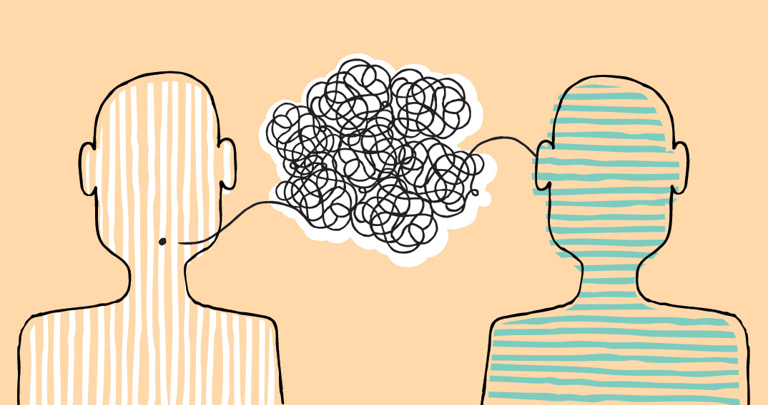
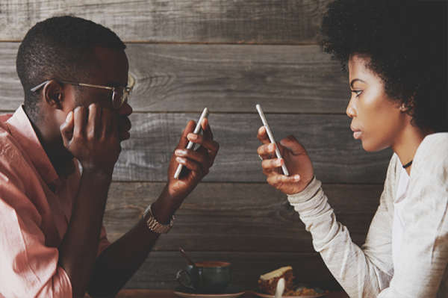
CHALLENGES OR BARRIERS
Lack of a plan
Not understanding your audience and their communication needs
A confused or unclear purpose to your communication
Poorly structured content
Over communicating
Radio silence
Not using an appropriate form of communication
An inability to form a connection with adults or people of authority
Poor audience engagement
Failure to gather lessons learned and continuously improve
Notes:
What are some of the barriers to good communications?
Disconnect: Miscommunication that creates frustration
Radio Silence: Too little communication that causes anxiety
Constant Pings: Too much communication that leads to annoyance

Slide 9

IMPLICATIONS
Poor communication costs us personally over the long term.
Notes:
What are we seeing or experiencing today that are examples of poor communication?
Miscommunication is the cause of many arguments and fights. Specific skills can be learned so others will understand your messages.
FACILITATOR - QUESTION FOR STUDENTS – “HAVE YOU EVER SAID OR WRITTEN ANYTHING AND THEN ASKED YOURSELF AFTERWARDS – “WHY DID I SAY THAT?” SOMETIMES WE MAY COMMUNCIATE SO QUICKLY WITHOUT THINKING THROUGH THE PURPOSE OR POSSIBLY THE ADVERSE AFFECT OF THE COMMUNCIATION.

Slide 10
Now, how can we do better?
... Glad You Asked!

Slide 11
Well developed communication
skills are ESSENTIAL SKILLS.

Slide 12
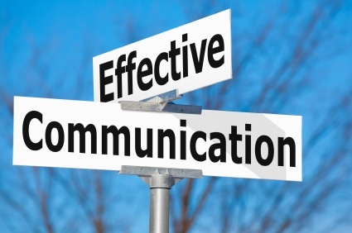
STRENGTHEN YOUR SKILLS
Think before you speak. “So What?” – Why does the information matter
Use a framework to think through and verbalize
  STAR (Situation/Task, Action and Result);
  SCAR or SPAB (Situation, Concern, Action and Result); (Situation, Position, Action and Benefit)
Be clear and direct
Deliver with confidence and impact
Look at the person and speak to him or her directly
Practice speaking and listening in natural settings
Seek to understand – Ask questions
Be empathetic
Adjust based upon your audience and what needs to be communicated
Notes:
THINK - why does it matter (for you and/or the listening audience) and any desired outcomes. Determine the essential information you need to communicate, based on the person’s current and required knowledge. Think through the risks by considering how you will answer any potential objections and correct any misconceptions.

Slide 13
STRENGTHEN YOUR SKILLS continued
Good posture, facial expressions and appropriate gestures
Be descriptive, but always use proper grammar and respectful vocabulary
Eliminate or minimize acronyms, jargon and other language that could be a barrier to the listener’s easy understanding of your message. Umms, Ands, So, You Know – are filler words to eliminate.
Try the power of the pause
Turn-taking – Don’t dominate the conversation
BE AUTHENTIC AND STRENGTHEN SELF!

Slide 14
TIPS FOR DIFFICULT DISCUSSIONS
Use "I statements.” Say things like, "I feel upset when you ___" instead of, "You're making me upset." Steer clear of blaming or accusing them of purposely trying to hurt you.
Be clear and direct. No one can read your mind, so tell them what you think, feel, and need.
Don’t push aside your feelings. Bring up things that bother you early on so they don’t build up and become bigger problems.
Build trust. Unless someone has given you a reason not to, believing that they’re telling you the truth and assuming that they mean well helps establish trust.
Ask questions. If you don't understand what they're saying or why, ask questions. Don’t make assumptions.
Talk in person. It's really easy to misunderstand or misinterpret a text message or email. Talking in person (or through video chat) will allow you to hear their tone of voice and see their body language.
Don’t yell. Getting angry or defensive during an argument is totally normal. But if you’re feeling upset or angry, take a break until you both cool off.
Be willing to apologize. Everyone makes mistakes. Saying you’re sorry (and meaning it) goes a long way in helping to move on after a fight.
BE AUTHENTIC AND STRENGTHEN SELF!

Slide 15
LET’S TALK
You received a grade on a school project that is lower than what you felt was deserved.
Response:
You gave me a “C” that I don’t like, and I want it changed to an “A”.
I’d like to understand why you gave me a “C” as I believe it should be an “A” based upon the grading criteria and project results.
Why did you give me a C? It ain’t fair and I think I should have an “A”.
Communication Purpose
INFORM
PERSUADE
DIRECT
Notes:
Activity –
Students select better communication option.

Slide 16
LET’S TALK!
Activity
Communication Purpose
INFORM
PERSUADE
DIRECT
Notes:
Descriptive Activities
b

Slide 17
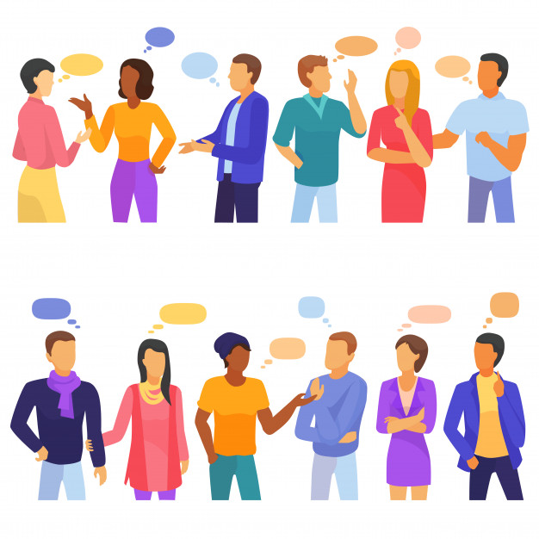
IT MATTERS
Rewards of Effective Communication:
Mutual understanding
Less chance of conflict
Cooperation from others
Meeting another's needs while getting your own needs met
Relief from negative emotions such as guilt, resentment or anger
Enhanced closeness
Care and goodwill
Encourage or influence progress
Accomplish goals

Slide 18

WE KNOW YOU CAN!
Impact
engagement
purpose
respect
DO IT WITH GREATER:

