Slide 1
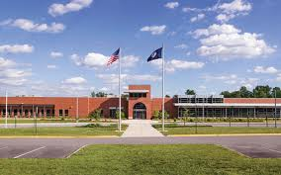
MEGA Who are you? Biography session

Slide 2
Who are you? Biography session
Core Values
RESPECT
RESPONSIBILITY
EFFORT
ACHIEVEMENT

Slide 3
Who are you? Personal Brand Statement for Students
Purpose is threefold:
Assist the students with developing their personal brand and gets them accustomed to introducing themselves to others.
Useful tool to help the mentors get to know the mentees by understanding more about their personal story.
Useful tool to help the mentees get to know the mentor by understanding more about their personal story.
Personal Biography

Slide 4
Who are you? Bio Content
A short bio is a great vehicle for quickly communicating who you are and what you do.
Key Elements
Family
Experiences
Goals and Aspirations

Slide 5
Who are you? Bio Content con’t
Personal Biography
What makes you unique?
Hobbies
Include a picture

Slide 6
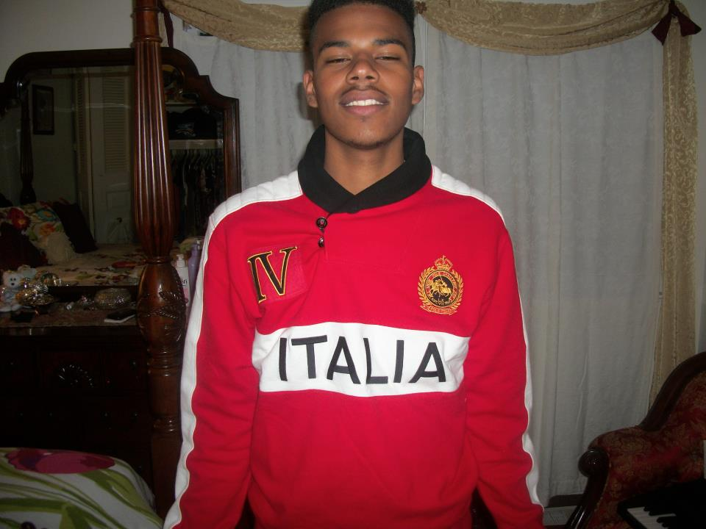
Who are you? BIO example (Mentee)
Jeffrey Depaula
I was born, October 24, 1996 in the Bronx, New York. I was raised by my lovely mother solo with an older brother Joel, and my baby sister who was three when my mother decided to move in 2001 to Richmond. I never thought she would leave the city forever. But that’s what she did.
At the age of five I was mind blown at the different scenery. I could not adjust to it because people were not used to my New York accent and the way I acted with so much energy. It seemed that everyone avoided me.
After a couple of years, in 2005, a certain event affected me and my family deeply. My mother had brain cancer. Nobody had told me anything. I was home alone around 10 or 11 in the afternoon. My sister’s Aunt called the house and she said my mother was at the hospital and had a strong headache. I though everything was ok. Then my aunt’s phone rang. It was my mom. She had wanted to speak to me so I spoke to her.

Slide 7
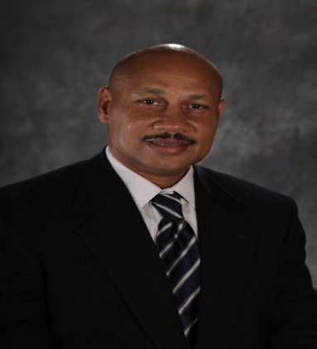
Who are you? BIO example (Mentor)
Rueben W. Turner
Rueben W. Turner manages the Supplier Diversity Development process for the Altria family of companies. In this position he is responsible for ensuring compliance with the Company’s Supplier Diversity Policy by implementing programs and processes that assure the inclusion of businesses owned by minorities and women whenever goods and services are purchased.
Rueben joined Philip Morris USA, in 1981, and has held several purchasing positions. As, Manager Machinery and Spare parts, he was responsible for supplier relationship management with Original Equipment Manufacturers. Prior to this assignment as Manager of Site Support Purchasing he was responsible for managing capital and service contracts to support the needs of multiple facilities. He has also held the position of Direct Materials Manager where he was responsible for the purchase of film, foil and tear-tape. He was a member of the world-wide synergy team for polyethylene film and tear- tape where he had the opportunity to travel extensively through Europe.
Rueben was born and raised in Hampton, Virginia and attended Bethel High School. He was a member of the football, basketball and track teams and helped the Bruins win multiple state championships in football and track and field.
Upon graduating high school, Rueben received a football scholarship from the University of Richmond where he graduated with a degree in Economics and Sociology. He obtained his Master in Business Administration from Queens University in Charlotte, North Carolina. He has a lifetime certification with the institute for Supply Management as a certified Purchasing Manager (C.P.M.) and recently attained ISM’s newest certification of Certified Professional in Supplier Diversity (CPSD).
His professional affiliations include membership with the Institute for Supply Management. He is a board member of the Carolina Virginia Minority Supplier Development Council.

Slide 8
Who are you? Bio Content con’t
Personal Biography
What makes you unique?
Hobbies
Include a picture

Slide 9
References and Contributors
List all papers, books, research sources or other contributors. This should be last page.

