Slide 1
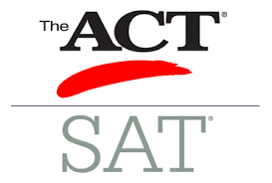
A BRIEF LOOK AT THE COLLEGE BOARDS
Which test is best for you?
SAT
SCHOLASTIC ASSESSMENT TEST
VS
ACT
AMERICAN COLLEGE TESTING
MEGA MENTORS
Shirl H. Leverett, PH.D.
JULY 2020

Slide 2
COLLEGE ENTRANCE EXAMS
2 MAJOR TESTS
SAT
ACT

Slide 3
TEST CONTENT
SCIENCE
SAT
NO
SCIENCE SECTION
ACT
✓

Slide 4
TEST CONTENT
SAT
WRITING & LANGUAGE
ACT
ENGLISH

Slide 5
TEST CONTENT
PASSAGE - BASED READING
ACT
QUESTIONS HAVE NO PARTICULAR ORDER.
QUESTIONS APPEAR RANDOMLY.
SAT
QUESTIONS FOLLOW THE ORDER OF THE PASSAGE.

Slide 6
TEST CONTENT
MATH
SAT
CALCULATOR
SECTION
NO
CALCULATOR
SECTION
ACT
CALCULATOR ON
ALL
SECTIONS
AND

Slide 7
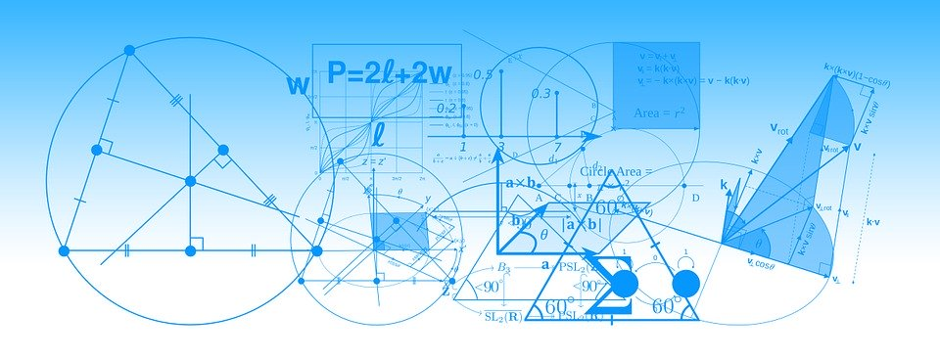
TEST CONTENT
MATH FORMULAS
SAT
PROVIDES 12
MATH FORMULAS
ACT
NO
FORMULAS PROVIDED
HAS
MORE GEOMETRY

Slide 8
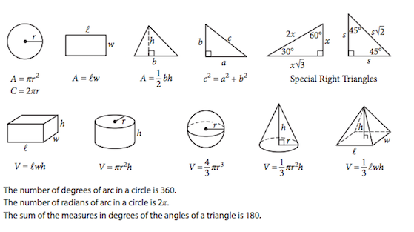
MATH FORMULAS PROVIDED ON THE SAT

Slide 9
EXAM CONTENT
THE
ESSAY IS OPTIONAL ON BOTH TESTS
SAT
OPTIONAL ESSAY
ACT
OPTIONAL ESSAY

Slide 10
HOW LONG IS EACH TEST?
SAT
3 hrs.
w/o
Essay
ACT
2 hrs. 55 min
w/o
Essay

Slide 11
Which test may be best for you?
https://www.kaptest.com/sat/sat-vs-act

