Slide 1
Resolving Conflict With Negotiation

Slide 2
Introduction
How do you handle conflict?
Fight?
Take Flight?
Hope it goes away?
Today we will cover techniques to resolving conflicts?

Slide 3
Ways to Resolve Conflict
Avoid Conflict
Simply withdraw from any conflict
Smooth it Over
Pretend its no conflict and everything is cool
Win at All Costs
–Get what you want the other person loses
Compromise
Give up something you want to get something you want
Win/Win Negotiation
Use creative problem solving to get both people what they need
Give examples of each from your own experiences
Which approaches do you use?
Which of the approaches cause the most problems?
Why are compromise or win/win useful strategies?

Slide 4
Compromise Example
A star athlete is about to sign with a pro team and is asking for $15.5 million signing bonus. The team, even though they want this star player to sign with them, is only prepared to pay him $5.5 million. The two reach an agreement that includes a compromise for both parties. The team offers and the athletes accept $10 million.
What is the name of the process that leads to this compromise?

Slide 5
Questions?
What are examples of where negotiations and compromise bring agreement?
What are the advantages and disadvantages of compromise?

Slide 6
Win/Win
Win/Win Negotiations Benefit Both Parties.
Why ? Give a few examples.

Slide 7
Steps to Successful Win/Win
Listen to the other person’s position
Find out what the other person wants and repeat it
Brainstorm win/win State Your position
Use I statements, say what you want or need
Considers both parties needs and search for creative solutions that work for both
Agree on a solution
Try it out, if it does not work, try another
Why do people have so much trouble negotiating a conflict to a solution
How might emotions get in the way of a win/win solution
What are examples of situations where you may be unwilling to compromise ( ie religious beliefs)
How easy would it be to introduce your parents to the negotiating technique?

Slide 8
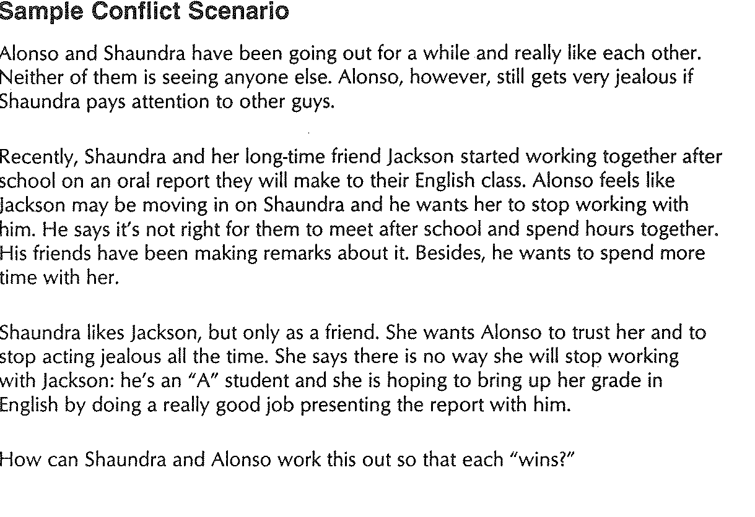

Slide 9
Exercise
In small groups, come up with a conflict (real or imagined) where the two parties have a difference in opinion, values or goals.
In your group, write down the situation, then come up with a script for the two parties to compromise using the 4 steps and come up with a win/win solution.
After you have written the conflict, be prepared to do a brief role play in which the negotiation takes place and a solution is reached.

