Slide 1
Making Money Work For You and Life Skills
This MEGA financial literacy summer program is for middle school students

Slide 2
MEGA Mentors
Weekly Agenda
Program Rules, Expectations & Core Values (15 minutes)
Icebreaker: Social Skills (10 minutes)
Lesson Overview & Discussion: (15 minutes)
Lesson Activities: (15 minutes)
Discussion/Wrap Up/Next Week’s (5 minutes)

Slide 3
Session 1 – Icebreaker: “The Inside Scoop-Get to Know Me”
The Inside Scoop
Activity

Slide 4
Session 1 – Program Rules, Expectations & MEGA’s Core Values
PowerPoint: L-05 MEGA RULES & EXPECTATIONS PowerPoint: PY - 02 WHO ARE YOU?

Slide 5
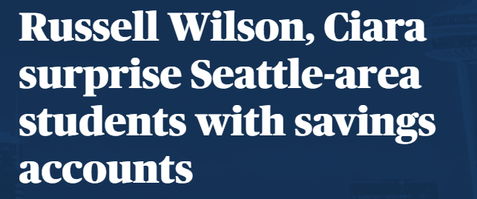
Session 1: Article
***Click the photo to read the article

Slide 6
Session 1: Lesson Overview
5-10 years
Discussion:
1-4 years
11-30 years
What will you spend money on as you get older?
Spend, save, invest-Nikki’s Weekly Budget
Vocabulary: Income, Expense
TIMELIME
Nikki’s Weekly Budget
INCOME EXPENSES
Allowance $10 Snacks $10
Dog Walking $25 Movies $15
Birthday Gift Card $50 Art Supplies $20
Total $85 Video Game $40
Total $85

Slide 7
Session 1: Lesson Activities (1)
Creating a Budget
INCOME
EXPENSES

Slide 8
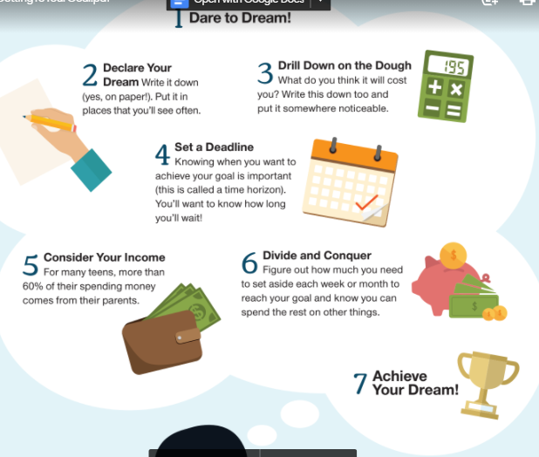
Session 1: Lesson Activities (2)
Getting to Your Goal
Dare to Dream
Declare Your Dream
Drill Down on the Dough
Set a Deadline
Consider Your Income
Divide and Conquer
Achieve Your Dream

Slide 9
Session 1: Lesson Activities (3)
My Financial Goal
My goal is to save $_______________ so that I can buy __________________ on this date ___________________.
I pledge to remember my goal when tempted to spend money on other things.

Slide 10
MEGA Mentors
Summary and Questions:
What is a budget?
What are two ways that you can earn income?
What are three different timelines for your goals?

Slide 11
Making Money Work For You and Life Skills

Slide 12
MEGA Mentors
Weekly Agenda – Week 2
Icebreaker: Social Skills (10 minutes)
Lesson Overview & Discussion: (20 minutes)
Lesson Activities: (25 minutes)
Discussion/Wrap Up/Next Week’s (5 minutes)

Slide 13
Session 2 – Decision Making
Questions to ask:
Name one positive thing about social media that students mentioned in the video.
2.Name one negative thing about social media that was mentioned by students in the video.
***Click the photo to read the article

Slide 14
Session 2: Article
***Click the photo to read the article

Slide 15
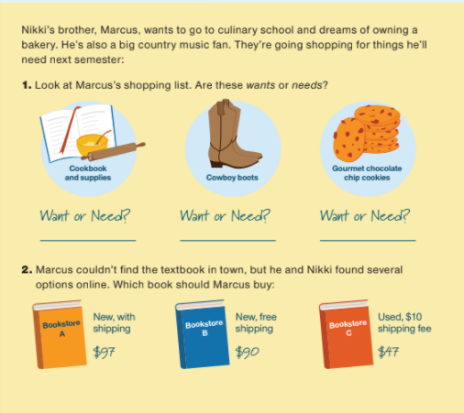
Session 2: Lesson Overview
Marcus’s Shopping List
Discussion:
Concept of “Saving and Spending Wisely?
Vocabulary – Needs, Wants, Credit, Credit Rating, Debt
Example: Nikki’s brother, Marcus, Needs vs Wants

Slide 16
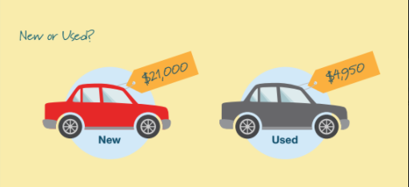
Session 2: Lesson Activities (1)
NEW OR USED?
A) PROS & CONS B) INTEREST C) CREDIT RATING

Slide 17
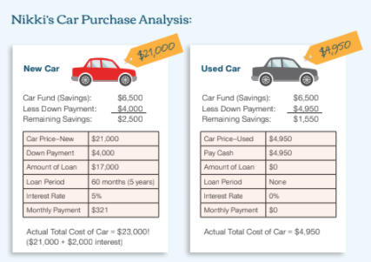
Session 2: Lesson Activities (2)
Discussion
1) What are unexpected expenses?
2) How will a monthly car payment affect Nikki’s income and her ability to save for other financial goals?
3) Which scenario will give Nikki a better chance of replenishing her savings- new or used car?
A) PROS & CONS B) INTEREST C) CREDIT RATING

Slide 18
MEGA Mentors
Summary and Questions:
What is credit? Good? Bad?
What are needs vs wants?
Name two kinds of unexpected expenses when buying a car.

Slide 19
Making Money Work For You and Life Skills

Slide 20
MEGA Mentors
Weekly Agenda – Week 3
Icebreaker: Social Skills (10 minutes)
Lesson Overview & Discussion: (20 minutes)
Lesson Activities: (25 minutes)
Discussion/Wrap Up/Next Week’s (5 minutes)

Slide 21
Session 3 – Social Skills: Handling Cyberbullying
Questions to ask:
1. Define Cyberbullying
2. What can you do if you are experiencing cyberbullying?
***Click the photo to read the article

Slide 22
Session 3: Article
***Click the photo to read the article

Slide 23
Session 3: Lesson Overview
Discussion:
Concept of Inflation
Long-term Goals
Vocabulary: Inflation

Slide 24
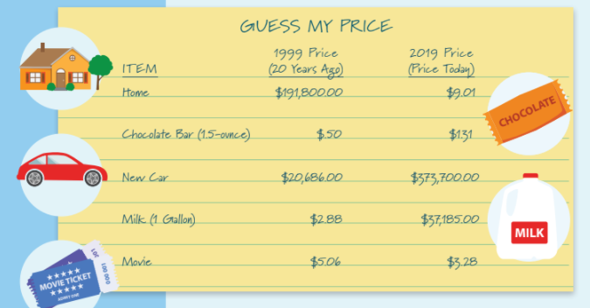
Session 3: Lesson Activities (1)
Guess My Price

Slide 25
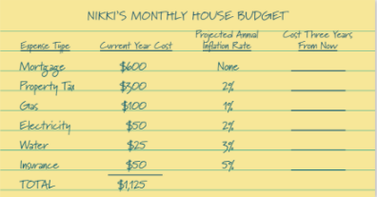
Session 3: Lesson Activities (2)
Nikki’s Monthly House Budget

Slide 26
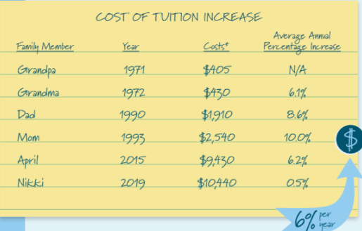
Session 3: Lesson Activities (3)
Cost of Tuition Increase

Slide 27
MEGA Mentors
Summary and Questions:
What is inflation?
What is the current cost of tuition for a college or university of your choice?

Slide 28
Making Money Work For You and Life Skills

Slide 29
MEGA Mentors
Weekly Agenda – Week 4
Icebreaker: Social Skills (10 minutes)
Lesson Overview & Discussion: (20 minutes)
Lesson Activities: (25 minutes)
Discussion/Wrap Up/Next Week’s (5 minutes)

Slide 30
Session 4 – Social Skills: “How to Deal with Conflicts”
QUESTION TO ASK:
1. Name two methods you will try when dealing with conflict
***Click the photo to read the article

Slide 31
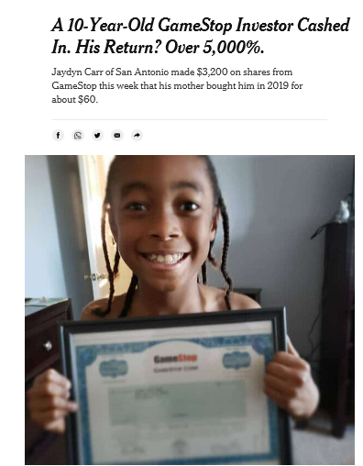
Session 4: Article
***Click the photo to read the article

Slide 32
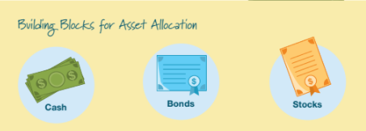
Session 4: Lesson Overview
Discussion:
Asset Allocation
Vocabulary: Bond (grandparents), Stock, Mutual Fund, 401(K)

Slide 33
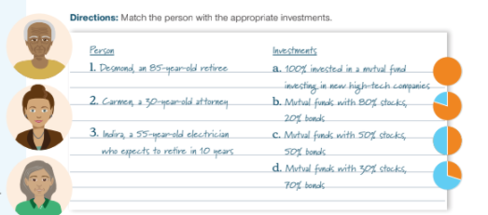
Session 4: Lesson Activities (1)
Match the Person w/the Investment

Slide 34
Session 4: Lesson Activities (2)
***Click the photo to read the article

Slide 35
MEGA Mentors
Summary and Questions:
What are stocks?
How can you acquire stocks?
What are three different types of asset allocation?

Slide 36
Making Money Work For You and Life Skills

Slide 37
MEGA Mentors
Weekly Agenda – Week 5
Icebreaker: Social Skills (10 minutes)
Lesson Overview & Discussion: (20 minutes)
Lesson Activities: (25 minutes)
Discussion/Wrap Up/Next Week’s (5 minutes)

Slide 38
Session 5 – Social Skills: Anger Management https://www.youtube.com/watch?v=DbpTohPUhMw

Slide 39
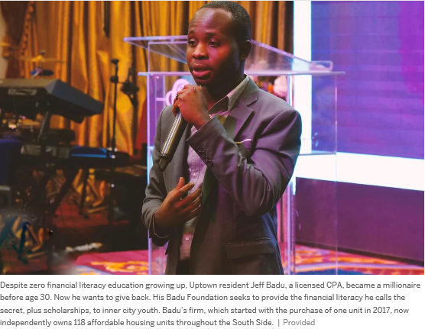
Session 5: Article
***Click the photo to read the article

Slide 40
Session 5: Lesson Overview
DIVERSIFIED PORTFOLIO
INTEREST RATES
CREDIT

Slide 41
MEGA Mentors
Summary and Questions:
How can you diversify your portfolio in the future?
How does a bank determine your interest rate for loans?
What is a good credit score?

Slide 42
Making Money Work For You and Life Skills

Slide 43
MEGA Mentors
Weekly Agenda – Week 6
Social Skills Overview: (10 minutes)
Lessons Overview: (10 minutes)
Guided Discussion: (25 minutes)
Evaluation/Survey (5 minutes)
Thank You/Awards: (10 minutes)

Slide 44
Session 6 – Social Skills Overview Friendships and social media Cyberbullying strategies Dealing with conflict strategies

Slide 45
Session 6: Lessons Overview
If you face cyberbullying, what are two approaches that you might try?
What techniques will you try the next time you have a conflict with an adult or peer?

Slide 46
Session 6: Lesson Overview: Making Money Work for You
Guided Discussion

Slide 47
Evaluation & Survey

