Slide 1
MEGA Mentors Summer Reading Program
Resources

Slide 2
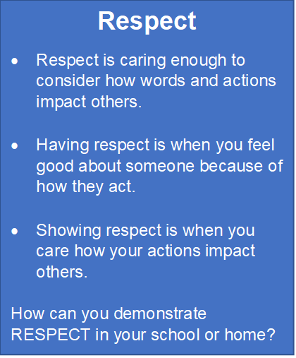
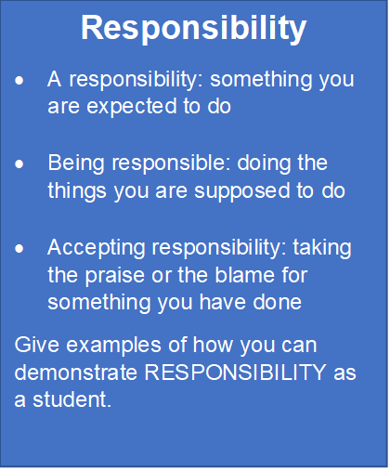
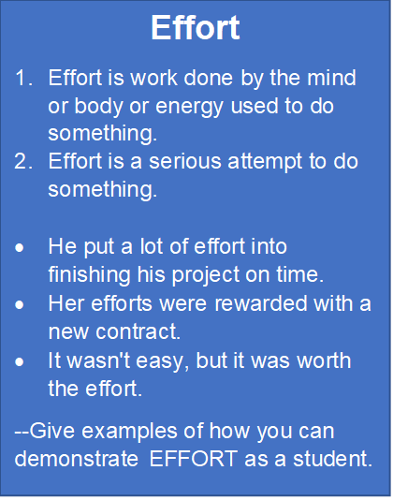
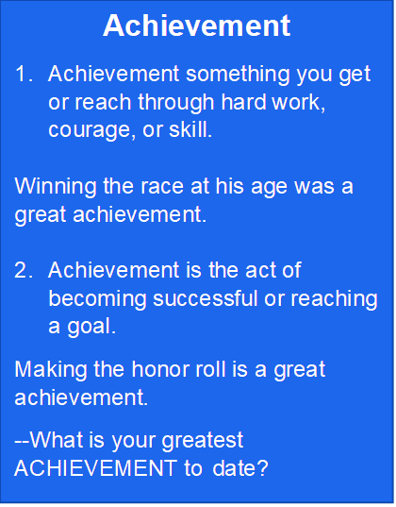
MEGA Mentors
Here are the Four Core Values:
Notes:
Ask the students to define each value in their own words. Then ask them why are these values important. After student responses, use the next slides to define and exemplify each value.

Slide 3
Getting to Know Me

Slide 4
Setting Goals

Slide 5
Summer Reading Program Game Board

