Slide 1
What Does Success Mean To You?
Success begins with a goal and ends with effort

Slide 2
Discussion Outline/Syllabus
What Does Success Mean to You?
Teaching Method: Small group discussion, role play
Course objectives:
Have the student create an image of personal success
Have the student communicate what it takes to achieve success
Communicate that failure is a path to success

Slide 3
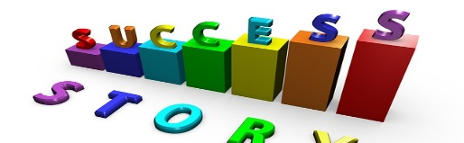
What does success mean to you?

Slide 4
What does success mean to you?
What is your “image” of success?
The dictionary defines success as the accomplishment of ones goals, or the attainment of wealth, position, honors, or the like.

Slide 5
Quotes from successful people
Always be yourself, express yourself, have faith in yourself, do not go out and look for a successful personality and duplicate it. Bruce Lee

Slide 6
Quotes from successful people
I've failed over and over and over again in my life and that is why I succeed. Michael Jordan

Slide 7
Quotes from successful people
You can't be afraid to fail. It's the only way you succeed - you're not gonna succeed all the time, and I know that. LeBron James

Slide 8
How do you interpret these quotes?

Slide 9
What does success mean to you now, and has your “image” of success changed?

Slide 10
What is your plan to become successful in life?

